Slide 1
CAPSTONE PROJECT
'Best OTT platform analysis'
Thamizhvanan G

Slide 2
Objective of Analysis
This research provides a comprehensive understanding of the market and user statistics of leading OTT platforms, along with a focus on content and viewer ratings.
The analysis is based on both global and regional data and aims to highlight the significant trends and factors influencing platform success in the increasingly crowded OTT market.

Slide 3
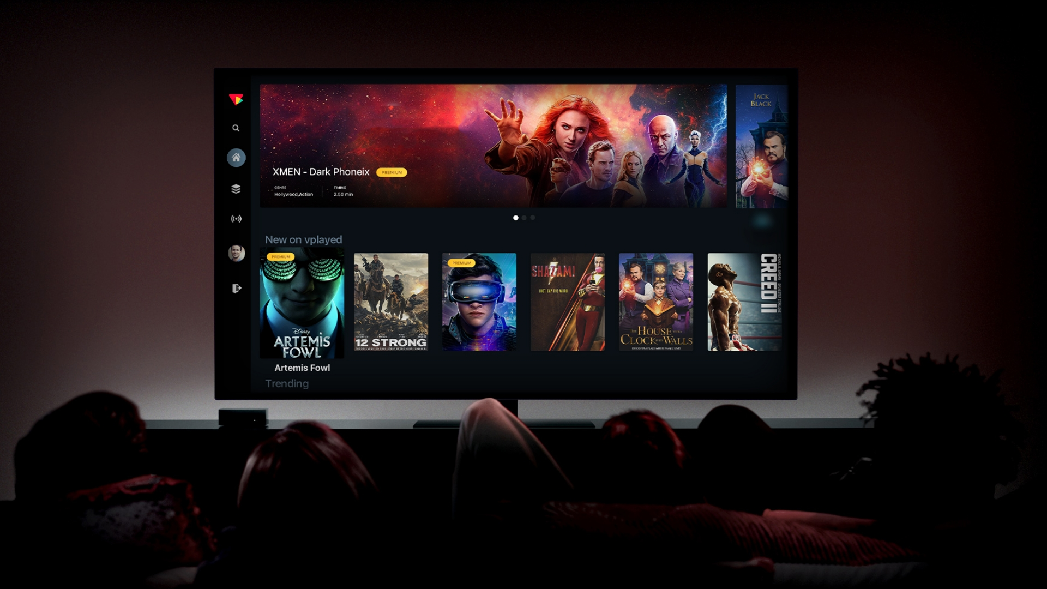
User Behavior and Preferences
Shift in Viewing Habits
Users are increasingly favoring OTT platforms over traditional TV due to flexibility and content variety.
Explosive Market Growth
OTT market has witnessed exponential growth in recent years.
Content Consumption Patterns
Understanding user preferences and viewing habits is crucial for platform success.

Slide 4
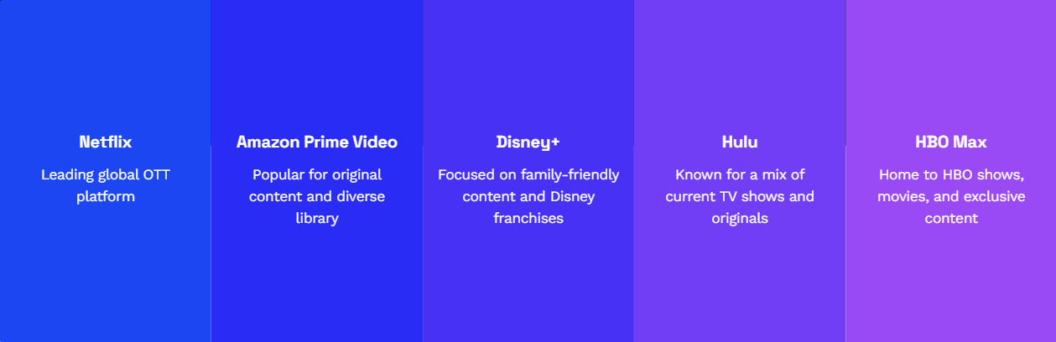
OTT Platforms Analysis
Major Players in the OTT Industry
Identifying Key OTT Platforms for Analysis

Slide 6
Netflix SWOT Analysis
Netflix's vast content library and original productions give it a competitive edge.
Dependency on licensed content and increasing competition pose challenges.
Strengths
Weaknesses
Opportunities
Threats
SWOT
Expansion into emerging markets and diversification of content genres.
Intensifying competition and potential subscriber saturation in mature markets.

Slide 7
Amazon Prime Video SWOT Analysis
Integration with Amazon Prime membership and diverse content offerings.
Limited regional content and a less intuitive user interface.
Strengths
Weaknesses
Opportunities
Threats
SWOT
Leveraging Amazon's global presence and investing in exclusive content.
Competition from other platforms and changing consumer preferences.

Slide 8
Disney+ Hotstar SWOT Analysis
Strong content portfolio, including Disney, Marvel, and Star Wars franchises.
Reliance on sports content and limited original programming.
Strengths
Weaknesses
Opportunities
Threats
SWOT
Expanding into new markets and leveraging Disney's brand power.
Intensifying competition and challenges in content acquisition.

Slide 9
Netflix
Amazon Prime Video
HBO Max
Disney+
Hulu

Slide 10
Platform Selection Criteria
Content Variety and Quality
User Experience
Users prioritize platforms with diverse, high-quality content offerings.
Intuitive interfaces and personalized recommendations enhance user satisfaction.
Value for Money
Global Accessibility
Subscription pricing and benefits influence user decisions.
Platforms with a wide global reach attract a broader audience.

Slide 11
OTT Platform Revenue Analysis
Comparison of Revenue Across Top OTT Platforms

Slide 12

Data-Driven Insights and Strategic Recommendations
Leveraging Analysis for Enhanced OTT Platform Performance
Expand Market Reach
Explore new demographics and territories for growth opportunities and increased market share.
Enhance User Engagement
Implement personalized recommendations and interactive features to increase user interaction.
Optimize Content Acquisition
Focus on acquiring high-demand and exclusive content to attract and retain users.

Slide 13
THANK YOU
Insert the Subtitle of Your Presentation

